Slide 1
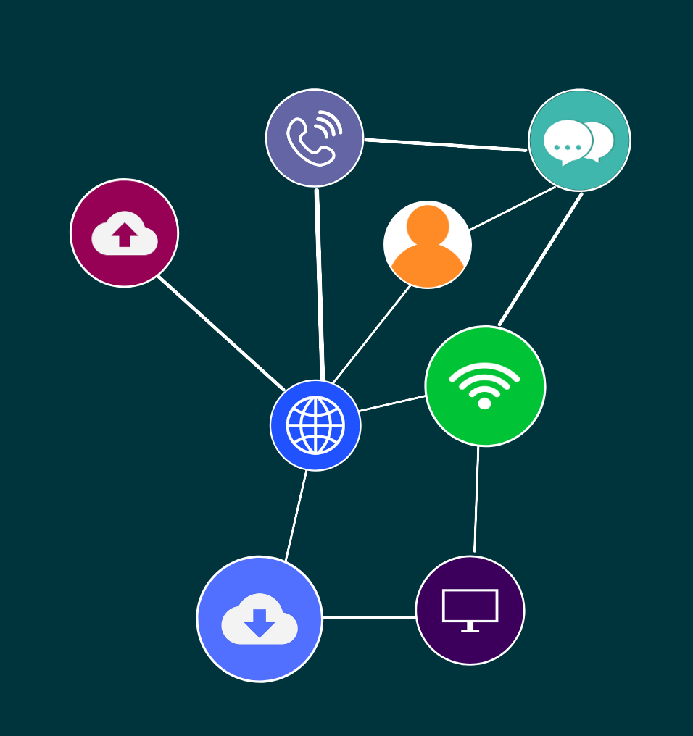

ICTNWK541
Configure, verify and troubleshoot WAN links and IP services

Slide 2
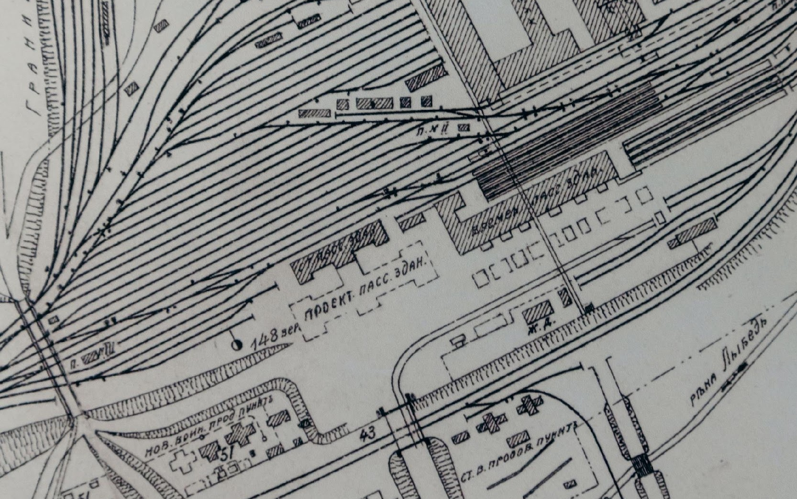
‹#›
Topic 1: Planning WAN links
© 2022 Milestones International College

Slide 3
‹#›
Most of today’s networking environments span great distances, forming wide area networks (WANS). To connect these networks you require the hardware, software, and various WAN technologies.
This unit focuses on configuring, verifying, and troubleshooting WAN links and IP services.
Topic 1: Planning WAN links
Topic 1: Insert topic title
© 2022 Milestones International College

Slide 4

‹#›
ACTIVITY: REFLECT
What type of documentation would you need to review the network design of a medium-size enterprise network?
Topic 1: Planning WAN links
© 2022 Milestones International College

Slide 5
‹#›
REVIEWING NETWORK DESIGN DOCUMENTATION
Existing network design documentation can help to understand the network layout, provide a broader understanding of how to troubleshoot and helps to recognise any trouble spots, outdated equipment and can support mitigating future troubleshooting.
Topic 1: Planning WAN links
Topic 1: Insert topic title
© 2022 Milestones International College

Slide 6
‹#›
ACTIVITY: READ
Review the following best practices to follow for network documentation.
Article: https://www.auvik.com/franklyit/blog/network-documentation-best-practices/
Write down your key takeaways after reading the article.
Topic 1: Planning WAN links
© 2022 Milestones International College

Slide 7
‹#›
ACTIVITY: DEMONSTRATION
Your trainer will provide you with an example of network design documentation and walk through the information. If you have any questions, please ask your trainer.
Topic 1: Planning WAN links
© 2022 Milestones International College

Slide 8
‹#›
SECURITY
With any network, there will be potential security vulnerabilities. Whilst you cannot secure every aspect 100%, you can find the weakest links that need protecting.
Topic 1: Planning WAN links
Topic 1: Insert topic title
© 2022 Milestones International College

Slide 9
‹#›
ACTIVITY: READ
Read the following information on switch security.
Article: https://thecybersecurityman.com/2018/01/30/switch-security/
Write down your key takeaways after reading the article.
Topic 1: Planning WAN links
© 2022 Milestones International College

Slide 10
‹#›
INSTALLATION PLANS AND CONTINGENCIES
Now that you have the documentation and security requirements, the next step is to develop and document an installation plan.
Topic 1: Planning WAN links
Topic 1: Insert topic title
© 2022 Milestones International College

Slide 11
‹#›
ACTIVITY: DEMONSTRATION
Your trainer will provide you with an example of an installation plan, and walk through the information. If you have any questions, please ask your trainer.
Topic 1: Planning WAN links
© 2022 Milestones International College

Slide 12
‹#›
CONTINGENCIES
As for any network installation, you would need to have a contingency plan in case of network failure, errors, system faults, equipment problems, routing errors, damage to hardware, malfunctions, or performance issues.
Topic 1: Planning WAN links
Topic 1: Insert topic title
© 2022 Milestones International College

Slide 13
‹#›
SIGN OFF
Once the installation plan has been completed, it will need to be approved and signed off from any required personnel.
Topic 1: Planning WAN links
Topic 1: Insert topic title
© 2022 Milestones International College

Slide 14
‹#›
ACTIVITY: CASE STUDY
You are required to install, configure and test Wide Area Network (WAN) links. For the first task you must plan and document a WAN link installation plan.
Topic 1: Planning WAN links
© 2022 Milestones International College

Slide 15

‹#›
Topic 2: Configuring and securing WAN links and IP services
© 2022 Milestones International College

Slide 16
‹#›
After the preparation activities have been complete, the next step would be configuring the WAN links, IP services on a router, and security.
Topic 2: Configuring and securing WAN links and IP services
Topic 1: Insert topic title
© 2022 Milestones International College

Slide 17
‹#›
ACTIVITY: READ AND DISCUSS
Read the following article on WAN security.
Article: https://www.tcsusa.com/security-consulting/wide-area-network-wan/
Write down your key takeaways after reading the article.
Discuss: What are the greatest causes of security risks for WANs?
Topic 2: Configuring and securing WAN links and IP services
© 2022 Milestones International College

Slide 18
‹#›
WAN CONNECTIONS
You can use the installation plan specifications to determine the WAN connection method requirements. For example, it would broadly include:
End user device, Modem, WAN Switch, Core Routers, cables, internet connection and service provider.
Topic 2: Configuring and securing WAN links and IP services
Topic 1: Insert topic title
© 2022 Milestones International College

Slide 19
‹#›
ACTIVITY: READ
Read the following document from Cisco on WAN connection methods.
Website: https://www.learncisco.net/courses/icnd-2/wan-technologies/wan-connections-overview.html
Topic 2: Configuring and securing WAN links and IP services
© 2022 Milestones International College

Slide 20
‹#›
SERIAL WAN CONFIGURATION AND WAN PROTOCOLS
WANs use serial transmission for long-distance communication, where bits of data are transmitted sequentially over a single channel.
Serial channels use specific electro-magnetic or optical frequency ranges.
When making configurations you must know how to connect to these ports and which cables to use.
Topic 2: Configuring and securing WAN links and IP services
Topic 1: Insert topic title
© 2022 Milestones International College

Slide 21
‹#›
ACTIVITY: READ
Read the following articles relating to configurations and protocols.
Website: https://www.cisco.com/c/en_au/products/switches/what-is-a-wan-wide-area-network.html#~what-it-is
Website: https://petri.com/csc_3_wan_protocols_you_should_know/
Website: https://www.cisco.com/c/en/us/td/docs/routers/access/800M/software/800MSCG/serconf.html
Topic 2: Configuring and securing WAN links and IP services
© 2022 Milestones International College

Slide 22
‹#›
VIRTUAL PRIVATE NETWORK (VPN)
A virtual private network (VPN) provides encrypted connection over the internet, creating a private data transmission.
Topic 2: Configuring and securing WAN links and IP services
Topic 1: Insert topic title
© 2022 Milestones International College

Slide 23
‹#›
ACTIVITY: READ
Read the following article on site-to-site VPN and how it works
Article: https://www.impactmybiz.com/blog/blog-site-to-site-vpn/
Review the following configurations relating to Azure virtual WAN site to site portal.
Document: https://docs.microsoft.com/en-us/azure/virtual-wan/virtual-wan-site-to-site-portal
Topic 2: Configuring and securing WAN links and IP services
© 2022 Milestones International College

Slide 24
‹#›
VIRTUAL PRIVATE NETWORK (VPN)
An asymmetric digital subscriber line (ADSL) facilitates fast data transmission and greater bandwidth, transferring data over copper telephone lines.
Topic 2: Configuring and securing WAN links and IP services
Topic 1: Insert topic title
© 2022 Milestones International College

Slide 25
‹#›
ACTIVITY: READ
ADSL configuration settings are device and provider dependent. Review the following examples from D-Link and USR.
Article: https://www.dlink.com.ph/how-do-i-configure-dgl-4300-wan-settings-for-adsl-modem/
Article: https://support.usr.com/support/9114/9114-ug/internet_wan.html
Write down your key takeaways after reading the article.
Topic 2: Configuring and securing WAN links and IP services
© 2022 Milestones International College

Slide 26
‹#›
ACTIVITY: CASE STUDY
Your turn! Refer to your installation plan and any vendor specifications for the network devices being installed.
Undertake the tasks provided.
Topic 2: Configuring and securing WAN links and IP services
© 2022 Milestones International College

Slide 27
‹#›
CONFIGURING VERIFYING IP SERVICES
We will now cover configuring, implementing and verifying a Dynamic Host Configuration Protocol (DHCP) router operation, internet protocol version 6 (IPv6) addressing, network address translation (NAT) requirements, and provide an example of a vendor specification.
Topic 2: Configuring and securing WAN links and IP services
Topic 1: Insert topic title
© 2022 Milestones International College

Slide 28
‹#›
DYNAMIC HOST CONFIGURATION PROTOCOL (DHCP)
Dynamic Host Configuration Protocol (DHCP) is a protocol automatically providing an internet protocol (IP) host with its IP address and any other elated confirmation information (for example the subnet mask and default gateway).
Topic 2: Configuring and securing WAN links and IP services
Topic 1: Insert topic title
© 2022 Milestones International College

Slide 29
‹#›
ACTIVITY: READ
Read the following article on configuring a Cisco router as a DHCP server.
Article: https://study-ccna.com/configure-cisco-router-as-dhcp-server/
Write down your key takeaways after reading the article.
Topic 2: Configuring and securing WAN links and IP services
© 2022 Milestones International College

Slide 30
‹#›
INTERNET PROTOCOL VERSION 6 (IPV6) ADDRESSING
Internet protocol version 6 (IPv6) is a protocol standard developed by Internet Engineering Task Force (IEWTF).
Topic 2: Configuring and securing WAN links and IP services
Topic 1: Insert topic title
© 2022 Milestones International College

Slide 31
‹#›
ACTIVITY: READ
Read the following article on IPv6 addressing and connectivity for Cisco.
Article: https://www.cisco.com/c/en/us/td/docs/ios-xml/ios/ipv6_basic/configuration/xe-3s/ip6b-xe-3s-book/ip6-add-basic-conn-xe.html
Read the following document from Oracle on configuring IPv6 enabled routers.
Website: https://docs.oracle.com/cd/E23823_01/html/816-4554/ipv6-config-tasks-5.html
Write down your key takeaways after reading the article.
Topic 2: Configuring and securing WAN links and IP services
© 2022 Milestones International College

Slide 32
‹#›
NETWORK ADDRESS TRANSLATION (NAT)
Network address translation (NAT) maps multiple local private addresses to a public one before transferring the information. If you want multiple devices to employ a single IP address, then you can utilise NAT.
Topic 2: Configuring and securing WAN links and IP services
Topic 1: Insert topic title
© 2022 Milestones International College

Slide 33
‹#›
ACTIVITY: READ
Read the following article on configuring dynamic NAT in Cisco devices.
Article: https://www.manageengine.com/network-configuration-manager/configlets/configure-dynamic-nat-cisco.html
Write down your key takeaways after reading the article.
Topic 2: Configuring and securing WAN links and IP services
© 2022 Milestones International College

Slide 34
‹#›
SECURING THE NETWORK USING ROUTER SERVICES
Access control lists (ACLs) are rules specifying which users or systems can access resources. They can be implemented for routers and switches to act as filters, managing which traffic is allowed to access the network.
Topic 2: Configuring and securing WAN links and IP services
Topic 1: Insert topic title
© 2022 Milestones International College

Slide 35
‹#›
ACTIVITY: READ
Read through the links provided for this activity and write down your key takeaways after reading the articles.
Topic 2: Configuring and securing WAN links and IP services
© 2022 Milestones International College

Slide 36
‹#›
ACTIVITY: CASE STUDY
Write down the configurations for DHCP, IPv6, and NAT and any verifications carried out.
Determine the purpose and types of ACLs that will be used and write down configurations according to network filtering requirements.
Explain how you will secure access to the network router, according to the installation plan specifications (ie it must relate to the installation).
Topic 2: Configuring and securing WAN links and IP services
© 2022 Milestones International College

Slide 37
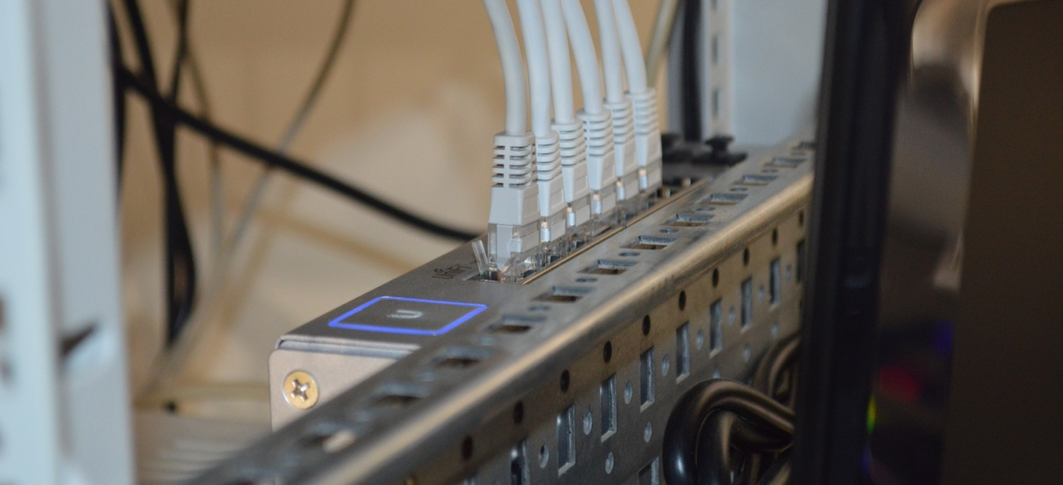
‹#›
Topic 3: Troubleshooting WAN links
© 2022 Milestones International College

Slide 38
‹#›
In this final topic we cover troubleshooting WAN links which includes testing, rectifying any issues, documenting test results and the methods used for rectification, and seeking and responding to feedback from relevant personnel.
Topic 3: Troubleshooting WAN links
Topic 1: Insert topic title
© 2022 Milestones International College

Slide 39
‹#›
ACTIVITY: DISCUSS
What are some main ways to troubleshoot a network?
What is the benefit for documenting troubleshooting and the results?
Topic 3: Troubleshooting WAN links
© 2022 Milestones International College

Slide 40
‹#›
TESTING WAN LINKS
Testing is always carried out throughout the installation stage, however, there are many steps that you would need to take post installation to ensure the safe and secure implementation of links.
Topic 3: Troubleshooting WAN links
Topic 1: Insert topic title
© 2022 Milestones International College

Slide 41
‹#›
ACTIVITY: READ
The following article covers different ways to test WAN performance.
Article: https://www.spirent.com/blogs/7-ways-to-test-sd-wan-performance
Write down your key takeaways after reading the article.
Topic 3: Troubleshooting WAN links
© 2022 Milestones International College

Slide 42
‹#›
ACTIVITY: CASE STUDY
Have a look at the router or switch on your case study network. Look up the debug commands for the router (find these online).
List some examples of debug commands and their purpose.
Topic 3: Troubleshooting WAN links
© 2022 Milestones International College

Slide 43
‹#›
RECTIFYING ISSUES
As implementation is carried out, you will be rectifying any issues as you conduct the testing.
Topic 3: Troubleshooting WAN links
Topic 1: Insert topic title
© 2022 Milestones International College

Slide 44
‹#›
RESPONDING TO FEEDBACK
Seek and respond to feedback from required personnel
Feedback plays an important part of the troubleshooting and testing process.
Topic 3: Troubleshooting WAN links
Topic 1: Insert topic title
© 2022 Milestones International College

Slide 45
‹#›
ACTIVITY: CASE STUDY
Refer to your case study.
Review the installation plan.
Undertake the tasks provided for this activity.
Topic 3: Troubleshooting WAN links
© 2022 Milestones International College

